Slide 1
COT5615: Math for Intelligent Systems I
Anand Rangarajan
Lecture 22

Slide 2
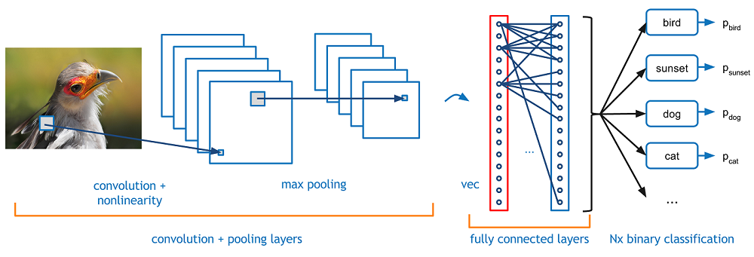
Convolutional Neural Networks and Deep Learning
Early stages in a deep learning architecture are usually convolution layers

Slide 3
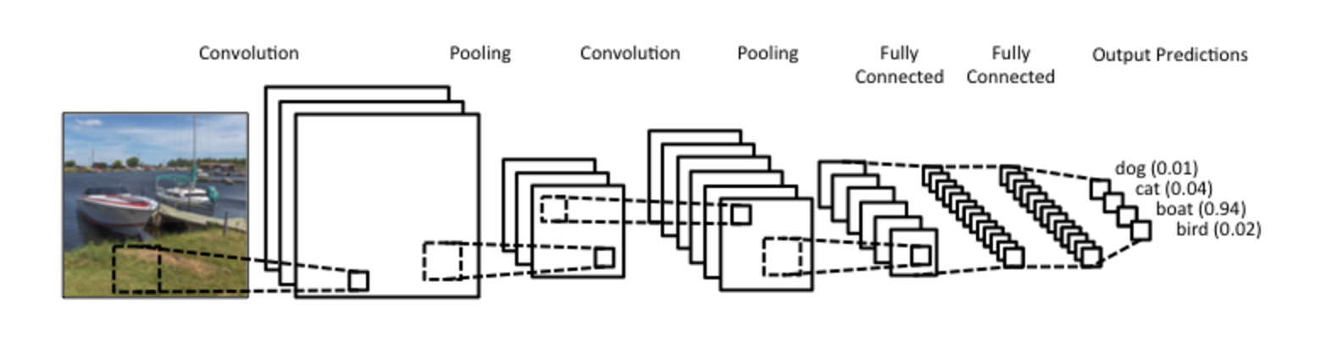
Convolution is like Filtering
Filtering yes but more mysterious

Slide 4
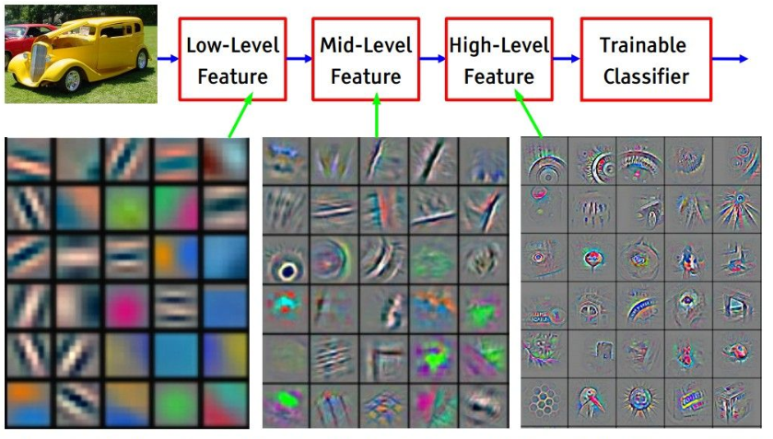
Low-level and high-level filtering

Slide 5
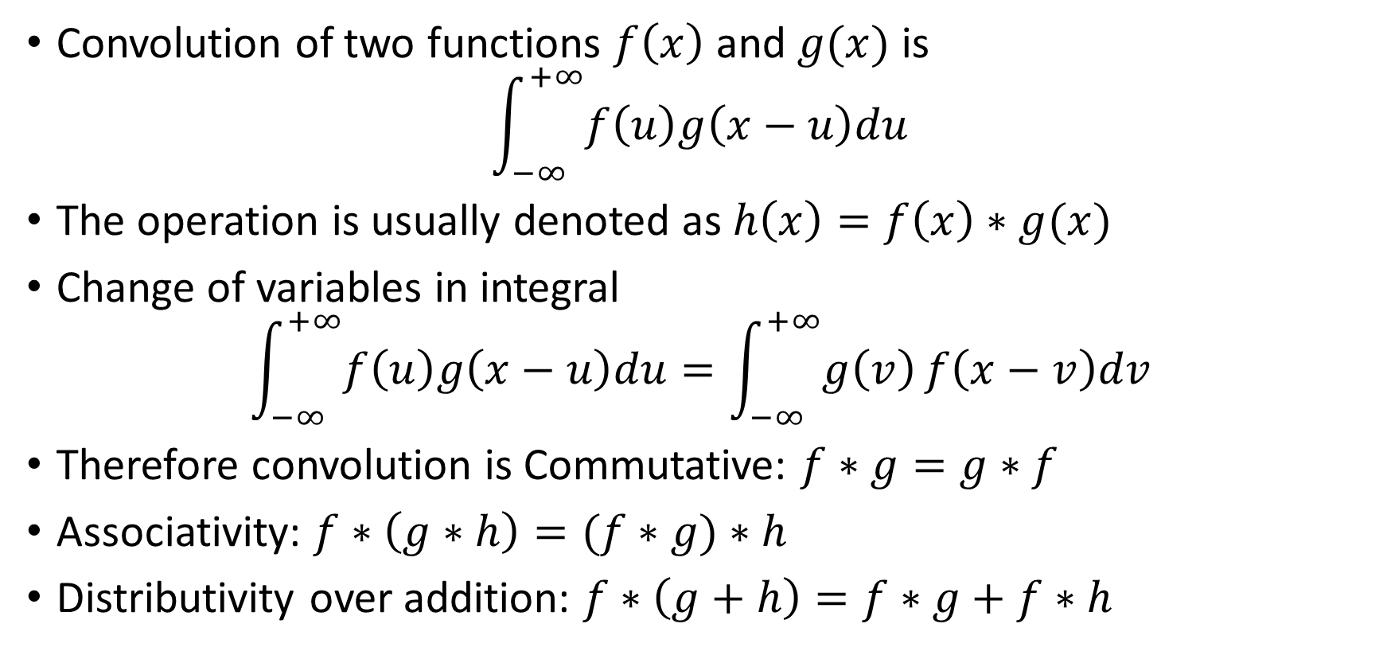
The Convolution Integral
Convolution of two functions $f\left(x\right)$ and $g(x)$ is
$$\int_{−∞}^{+∞}{f\left(u\right)g\left(x−u\right)du}$$
The operation is usually denoted as $h\left(x\right)=f\left(x\right)∗g(x)$
Change of variables in integral
$$\int_{−∞}^{+∞}{f\left(u\right)g\left(x−u\right)du}=\int_{−∞}^{+∞}{g\left(v\right)}f\left(x−v\right)dv$$
Therefore convolution is Commutative: $f∗g=g∗f$
Associativity: $f∗\left(g∗h\right)=(f∗g)∗h$
Distributivity over addition: $f∗\left(g+h\right)=f∗g+f∗h$

Slide 6
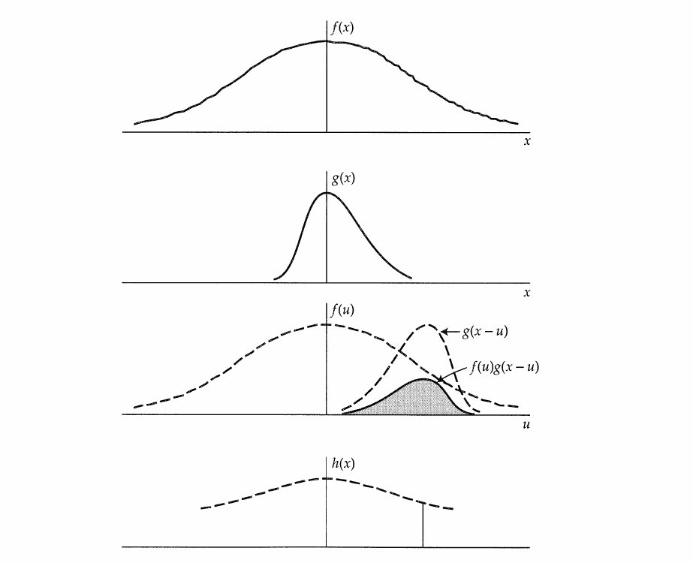

Slide 7
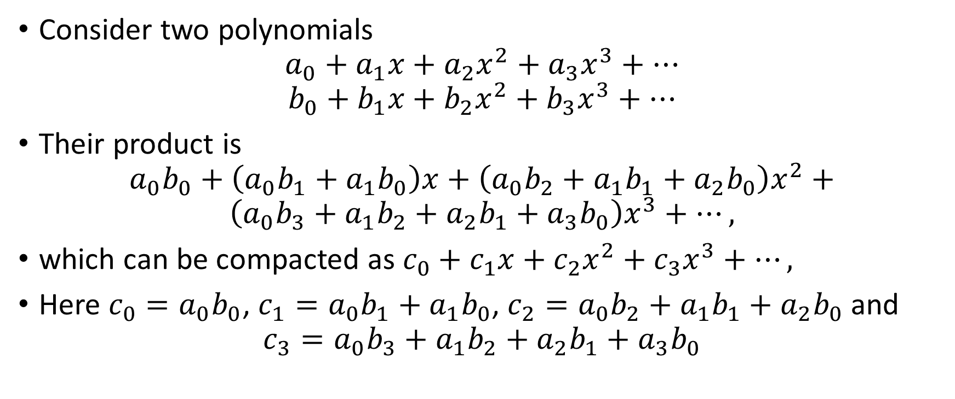
Serial Products
Consider two polynomials
$$a_{0}+a_{1}x+a_{2}x^{2}+a_{3}x^{3}+⋯$$
$$b_{0}+b_{1}x+b_{2}x^{2}+b_{3}x^{3}+⋯$$
Their product is
$$a_{0}b_{0}+\left(a_{0}b_{1}+a_{1}b_{0}\right)x+\left(a_{0}b_{2}+a_{1}b_{1}+a_{2}b_{0}\right)x^{2}+$$
$$\left(a_{0}b_{3}+a_{1}b_{2}+a_{2}b_{1}+a_{3}b_{0}\right)x^{3}+…,$$
which can be compacted as $c_{0}+c_{1}x+c_{2}x^{2}+c_{3}x^{3}+…,$
Here $c_{0}=a_{0}b_{0}$, $c_{1}=a_{0}b_{1}+a_{1}b_{0}$, $c_{2}=a_{0}b_{2}+a_{1}b_{1}+a_{2}b_{0}$ and
$$c_{3}=a_{0}b_{3}+a_{1}b_{2}+a_{2}b_{1}+a_{3}b_{0}$$

Slide 8
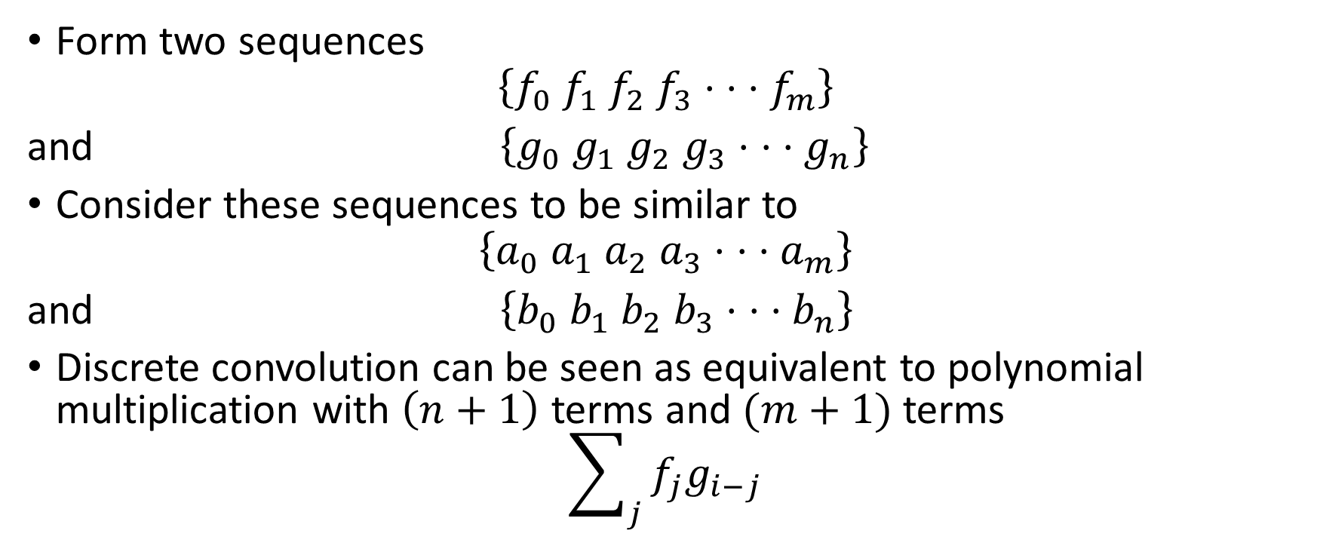
Serial Products and Discrete Convolution
Form two sequences
$$\left\{f_{0} f_{1} f_{2} f_{3}⋅ ⋅ ⋅f_{m}\right\}$$
and $\left\{g_{0} g_{1} g_{2} g_{3}⋅ ⋅ ⋅g_{n}\right\}$
Consider these sequences to be similar to
$$\left\{a_{0} a_{1} a_{2} a_{3}⋅ ⋅ ⋅a_{m}\right\}$$
and $\left\{b_{0} b_{1} b_{2} b_{3}⋅ ⋅ ⋅b_{n}\right\}$
Discrete convolution can be seen as equivalent to polynomial multiplication with $\left(n+1\right)$ terms and $(m+1)$ terms
$$\sum_{j}{f_{j}g_{i−j}}$$

Slide 9
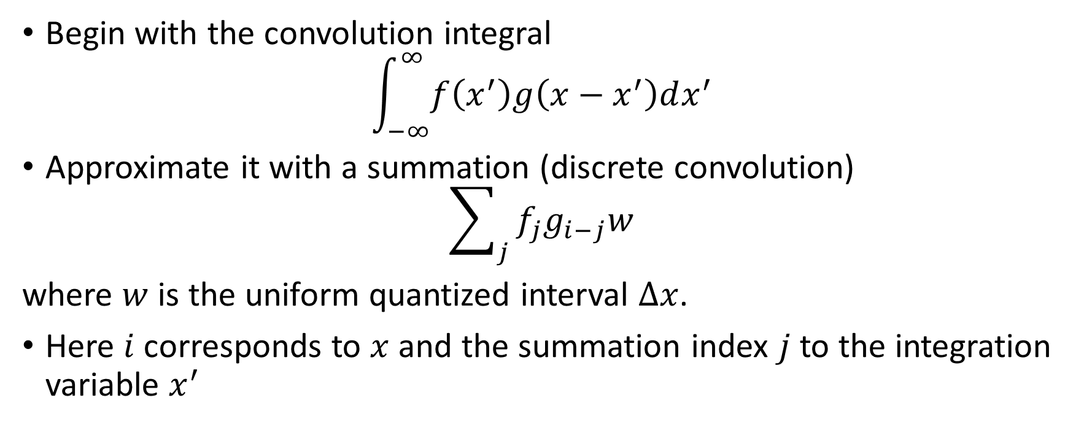
Approximating the convolution integral
Begin with the convolution integral
$$\int_{−∞}^{∞}{f\left(x^{′}\right)g\left(x−x^{′}\right)dx^{′}}$$
Approximate it with a summation (discrete convolution)
$$\sum_{j}{f_{j}g_{i−j}w}$$
where $w$ is the uniform quantized interval $Δx$.
Here $i$ corresponds to $x$ and the summation index $j$ to the integration variable $x^{′}$

Slide 10





















Approximate value of convolution integral
$$f_{0} f_{1} f_{2} f_{3}⋅ ⋅ ⋅ f_{m}$$
$$]$$
$$f_{0}g_{0}w$$
$$g_{n}⋅ ⋅ ⋅g_{3} g_{2} g_{1} g_{0}$$
$$f_{0} f_{1} f_{2} f_{3}⋅ ⋅ ⋅ f_{m}$$
$$]$$
$$\left(f_{0}g_{1}+f_{1}g_{0}\right)w$$
$$g_{n}⋅ ⋅ ⋅g_{3} g_{2} g_{1} g_{0}$$
$$f_{0} f_{1} f_{2} f_{3}⋅ ⋅ ⋅ f_{m}$$
$$]$$
$$\left(f_{0}g_{2}+f_{1}g_{1}+f_{2}g_{0}\right)w$$
$$g_{n}⋅ ⋅ ⋅g_{3} g_{2} g_{1} g_{0}$$
$$⋅ ⋅ ⋅$$
$$⋅ ⋅ ⋅$$
$$]$$
$$f_{0} f_{1} f_{2} f_{3}⋅ ⋅f_{m−1}f_{m}$$
$$\left(f_{m−1}g_{n}+f_{m}g_{n−1}\right)w$$
$$g_{n} g_{n−1}$$
$$f_{0} f_{1} f_{2} f_{3}⋅ ⋅ ⋅ f_{m}$$
$$]$$
$$f_{m}g_{n}w$$
$$g_{n}$$

Slide 11
The Convolution Sequences
$$\left\{f\right\}=\left\{f_{0} f_{1} f_{2}⋅ ⋅ ⋅f_{m}\right\}$$
$$\left\{g\right\}=\left\{g_{0} g_{1} g_{2}⋅ ⋅ ⋅g_{n}\right\}$$
resulting in
$$\left\{h\right\}=\left\{h_{0} h_{1} h_{2}⋅ ⋅ ⋅h_{m+n}\right\}$$

Slide 12
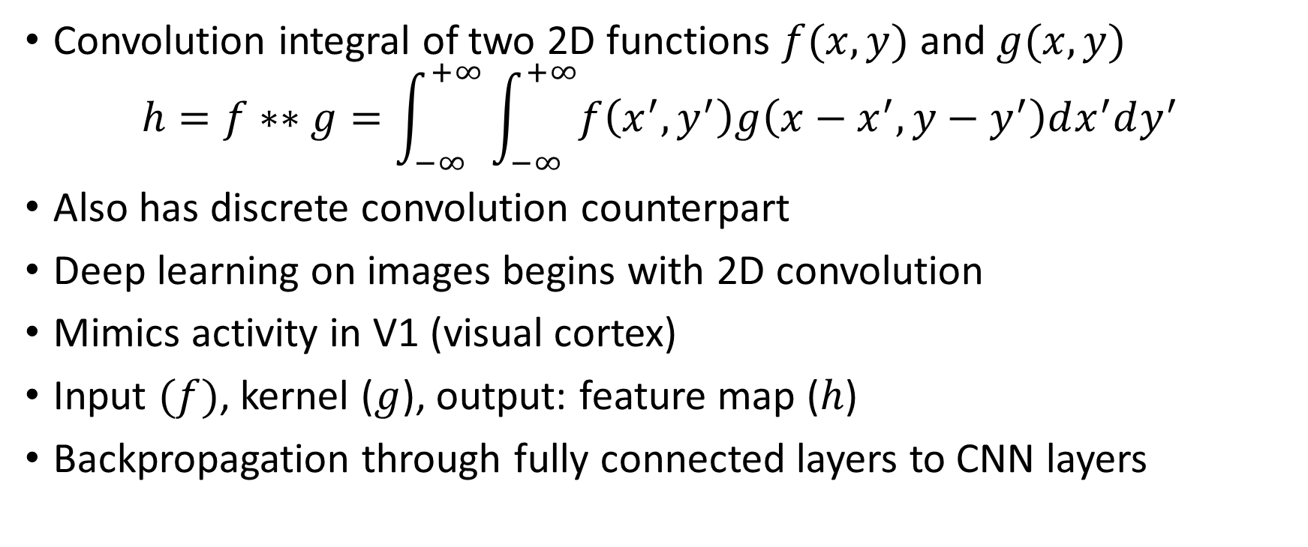
Two-dimensional convolution
Convolution integral of two 2D functions $f(x,y)$ and $g(x,y)$
$$h=f∗∗g=\int_{−∞}^{+∞}{\int_{−∞}^{+∞}{f\left(x^{′},y^{′}\right)g\left(x−x^{′},y−y^{′}\right)dx^{′}dy^{′}}}$$
Also has discrete convolution counterpart
Deep learning on images begins with 2D convolution
Mimics activity in V1 (visual cortex)
Input $(f)$, kernel ($g$), output: feature map ($h$)
Backpropagation through fully connected layers to CNN layers

